Slide 1
Customs and Indirect tax matters on the withdrawal of the United Kingdom from the European Union
Seminar Industry and Trade
Prague, 17 December 2018

Slide 2
Taskforce on Article 50 negotiations with the United Kingdom
In charge of preparing and conducting the negotiations with the UK, taking into account the framework of its future relationship with the European Union and ensure an orderly withdrawal
Coordinating the European Commission's work on all strategic, operational, legal and financial issues related to negotiations with the United Kingdom

Slide 3
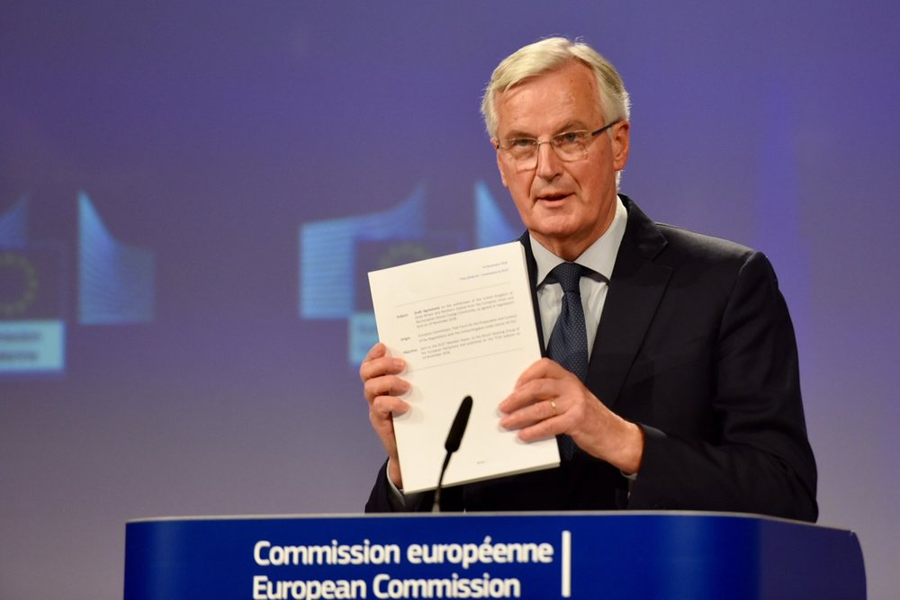
We have negotiated with the UK, never against the UK.
This deal is a necessary step to build trust between the UK and the EU. We need to build, in the next phase, an unprecedented and ambitious partnership.
The UK will remain our friend, our partner and our ally.
Michel Barnier, the European Commission’s Chief Negotiator, at the Special Meeting of the European Council (Article 50), 25 November 2018

Slide 4
WHAT IS THE WITHDRAWAL AGREEMENT?
The UK will leave the EU at midnight on 29 March 2019.
The Withdrawal Agreement ensures that this will happen in an orderly manner.
Article 50.2 of the Treaty on European Union:
"A Member State which decides to withdraw shall notify the European Council of its intention.
In the light of the guidelines provided by the European Council, the Union shall negotiate and conclude an agreement with that State, setting out the arrangements for its withdrawal, taking account of the framework for its future relationship with the Union. […]"

Slide 5
MAIN AREAS COVERED BY THE WITHDRAWAL AGREEMENT (1/2)
Common provisions (Part I)
Citizens' rights (Part II)
Setting out cross-cutting clauses for the proper understanding and operation of the Withdrawal Agreement.
Protecting the life choices of over 3 million EU citizens in the UK, and over 1 million UK nationals in EU countries, safeguarding their right to live, work or study in their host country.
Separation issues (Part III)
Transition (Part IV)
Ensuring an orderly withdrawal, notably through a smooth winding-down of ongoing procedures and arrangements applicable at the end of the transition period.
Providing for a transition period, until the end of 2020, which can be extended once, by up to one or two years.
Ensuring continued application of EU law in and to the UK during that period (but without UK participation in EU institutions and governance structures)
Providing more time for administrations, businesses and citizens to adapt.
Financial settlement (Part V)
Ensuring that the UK and the EU honour all financial obligations undertaken jointly while the UK was a Member State.

Slide 6
MAIN AREAS COVERED BY THE WITHDRAWAL AGREEMENT (2/2)
Governance (Part VI)
Protocol on the Sovereign Base
Areas (SBAs) in Cyprus
Ensuring the effective management, implementation and enforcement of the agreement, including an effective dispute settlement mechanism.
Protecting the interests of Cypriots who live and work in the Sovereign Base Areas.
Protocol on Ireland
and Northern Ireland
Protocol on Gibraltar
No hard border between Ireland and Northern Ireland.
No diminution of rights set out in the Good Friday (Belfast) Agreement 1998. North-South cooperation protected.
Continuation of the Common Travel Area arrangements between Ireland and the UK, and preservation of the Single Electricity Market
Providing for administrative cooperation between Spain and the UK in respect of Gibraltar in a number of policy areas during the transition period and on the implementation of the citizens' rights part of the Withdrawal Agreement.

Slide 7
The Withdrawal Agreement Separation issues
Customs: Articles 47-50 (Title II of Part III)
Value Added Tax and Excise: Articles 51-53 (Title III of Part III)
Basic principle:
‘grandfathering’ of EU rules for ongoing procedures and movements at the end of the transition period

Slide 8
The Withdrawal Agreement Separation issues Customs: Articles 47-50 (Title II of Part III)
Article 47
Customs procedures started before the end of the transition period can be finalised after withdrawal on the basis of the rules and requirements applied before
Pre-conditions: status of the goods (Union or non-Union) is to be demonstrated & that transport of a movement has started before the end of the transition period

Slide 9
The Withdrawal Agreement Separation issues Customs: Articles 47-50 (Title II of Part III)
Article 48 – § 1
Waiving the need for a pre-arrival entry summary declaration (ENS) in case this has been lodged before the end of the transition period

Slide 10
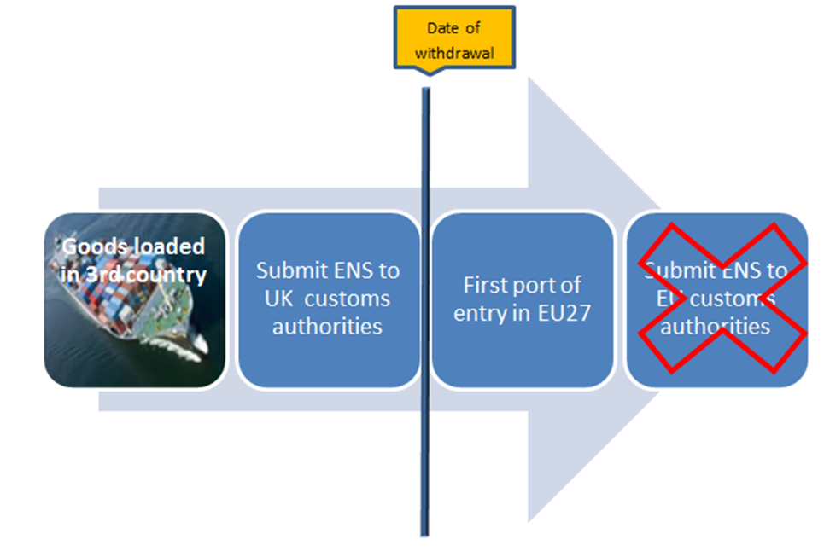

Slide 11
The Withdrawal Agreement Separation issues Customs: Articles 47-50 (Title II of Part III)
Article 48 – § 2
Waiving the need for a pre-departure declaration (EXS) in case this has been lodged before the end of the transition period

Slide 12
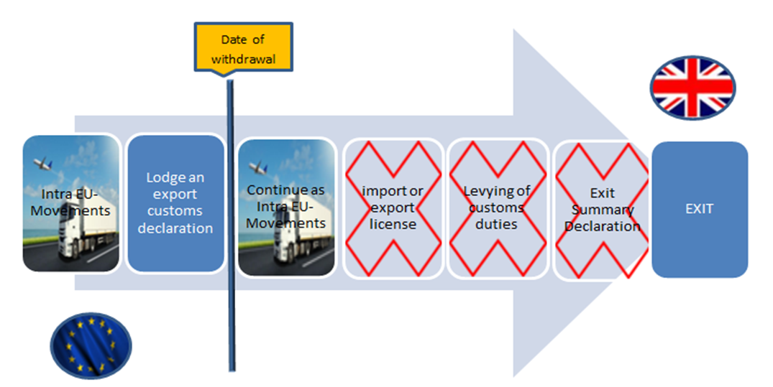

Slide 13
The Withdrawal Agreement Separation issues Customs: Articles 47-50 (Title II of Part III)
Article 49
Goods placed under a customs procedure before the withdrawal date will continue under that procedure under the same rules and conditions of the Union Customs Code as they were applicable in the UK and EU before the date of withdrawal
Non-Union goods placed under transit procedure in UK before withdrawal date
Reaching destination and ending transit in Prague after the withdrawal date
Continue to apply EU customs rules when ending the ongoing customs procedure
Time limits in Annex III

Slide 14
The Withdrawal Agreement Separation issues Customs: Articles 47-50 (Title II of Part III)
Article 50
UK authorities have continued access to relevant networks, information systems and databases
Listing in Annex IV

Slide 15
The Withdrawal Agreement Separation issues Indirect tax: Articles 51-53 (Title II of Part III)
Article 51 (VAT) - § 1
To avoid a double taxation ground (e.g. import and intra-EU acquisition)
Example: B2B supply of goods from UK to CZ. Transport starts 30.12.2020 - goods arrive in Prague 1.1.2021.
When it is proven to customs that transport started before the withdrawal, no import VAT is due and the transaction will be treated as an intra-EU supply and acquisition.

Slide 16
The Withdrawal Agreement Separation issues Indirect tax: Articles 51-53 (Title II of Part III)
Article 51 (VAT) – § 2
Taxable person’s rights and obligations
Transaction with a 'cross-border element'
No listing of specific rights and obligations, it is better to use a general and broad description.

Slide 17
The Withdrawal Agreement Separation issues Indirect tax: Articles 51-53 (Title II of Part III)
Article 51 (VAT) – § 3
Refund applications
At the latest by 31.3.2021
Limit the 'post-transition' effects of the withdrawal agreement

Slide 18
The Withdrawal Agreement Separation issues Indirect tax: Articles 51-53 (Title II of Part III)
Article 51 (VAT) – § 4
Amendments to returns related to services: telecommunications, broadcasting and electronic services
At the latest by 31.12.2021
Limit the 'post-transition' effects of the withdrawal agreement

Slide 19
The Withdrawal Agreement Separation issues Indirect tax: Articles 51-53 (Title II of Part III)
Article 52 (Excise)
Movements starting before the end of the transition period and ending thereafter to be treated as intra-EU excise movement
150 days: cover maximum guarantee lifetime
Example: Duty Suspension - EMCS
Allowed: actions that do not create or modify an e-AD => report of receipt | export, cancellation, etc.
=> no new e-AD, no Split or Change of Destination
Fallback documents allowed

Slide 20
The Withdrawal Agreement Separation issues Indirect tax: Articles 51-53 (Title II of Part III)
Article 53 (VAT & Excise)
UK authorities continue access to relevant networks, information systems and databases
Listing in Annex IV

Slide 21
What happens during the transition period – until the end of 2020?
EU law continues to apply to and in the UK as if it were a Member State
UK remains in the EU Customs Union and the Single Market with all four freedoms, and all EU policies.
UK remains bound by obligations stemming from all EU international agreements. In the area of trade, this means that third countries keep the same level of access to the UK market. The UK cannot apply new agreements in areas of EU exclusive competence, unless authorised to do so by the EU.
UK is no longer represented in EU institutions, agencies and bodies

Slide 22
Preparedness
No Withdrawal Agreement: NO TRANSITION PERIOD
Seven things businesses in the EU27 need to know: https://ec.europa.eu/info/sites/info/files/factsheet-preparing-withdrawal-brexit-preparedness-web_en.pdf
Brexit checklist for traders (soon)
TAXUD webpage: https://ec.europa.eu/taxation_customs/uk_withdrawal_en

Slide 23
Brexit preparedness notices: https://ec.europa.eu/info/brexit/brexit-preparedness/preparedness-notices_en#tradetaxud
Notice to stakeholders – customs and indirect taxation 30.01.2018 https://ec.europa.eu/info/sites/info/files/file_import/customs_and_indirect_taxation_en.pdf
Notice to stakeholders – import and export licenses 25.01.2018 https://ec.europa.eu/info/sites/info/files/file_import/import_and_export_licences_en.pdf
Notice to stakeholders – Preferential rules of origin 4.06.20 https://ec.europa.eu/info/sites/info/files/file_import/preferential_rules_of_origin_en.pdf

Slide 24
The Future Relationship

Slide 25
What does the Withdrawal Agreement say on the future relationship negotiations?
The EU and the UK will use their best endeavours to negotiate the agreements on the future relationship expeditiously.
They both commit to act in good faith.
The common goal is to make sure that such agreements apply from the end of the transition period to the extent possible.
The use of the best endeavours must fully respect the legal orders of the EU and the UK.
This means that negotiations will only start once the UK will have left the EU.

Slide 27
Veterinarian and Phyto sanitarian authorities (SPS – BIP)
Security authorities
Market Surveillance Authorities
Customs in cooperation with
Security & Safety controls
AT THE BORDER
Pre-arrival declarations security controls ('bomb in the box')
Financial Controls
At customs office of import
Risk based controls on the basis of customs declarations for all goods placed under a customs procedure (Union Customs Code)
Market Surveillance
At customs office of import
For industrial products
Products of animal origin
Animal by-products not intended for human consumption
Personal consignments of products of animal origin
Plastic kitchenware from China and Hong Kong
Fresh fruit and vegetables
High risk food and feed of non-animal origin
Okra, curry leaves from India
Unauthorised GM rice in rice products from China
Food and feed from Fukushima
Guar gum from India
Plant health
Pelts of certain animal species originating from countries using leghold traps
Invasive alien species
Live animals
Origin/Proof of status free circulation
Customs value
Customs duties
VAT
Excise
Ensure that only compliant products are placed on the Union market (Regulation (EC) no 765/2008
Classification of goods
Checks based on risk assessment, suspension of release for free circulation, decision by market surveillance authorities, refusal, or authorisation to release
68 legal instruments harmonising EU rules on non-food products (e.g. type-approval of motor vehicles, safety of toys, ozone layer depleting substances, CE-marking, EU Ecolabel, pyrotechnic articles, explosives for civil uses, personal protective equipment)
Specific rules for medicinal products for human and veterinary use
Customs Union

Slide 29
Future relationship
UK red lines:
- No free movement;
- No substantial financial contribution;
- Regulatory autonomy.
UK red lines:
- No ECJ jurisdiction;
- Regulatory autonomy.
UK leaves
the EU
UK red lines:
- Independent trade policy.
UK red lines:
- No ECJ jurisdiction;
- No free movement;
- No substantial financial contribution;
- Regulatory autonomy.
No deal

